Slide 1

Introduction to Graphical Design
Group Members:
Rickcolet Benjamin 2201010382
Markland Palmer 2017002490
Jamario Downer 2201011535
Glendon Hill 2201011879
Camoy Edwards 2201011768

Slide 2
Abstract
Websites are very crucial as they act as a guide to researchers in helping to find specific information. In this presentation information will be provided on the purpose, function, and design of our website. Followed by the difficulties that we experienced and a concise show of how the site functions.

Slide 3
Objectives
At the end of our presentation you will be able to:
Understand the concepts of this website
The designs of this website
The description of each page and what it can do.
The challenges that we encountered in completion of this website

Slide 4
Concept
Name of the Website: Mystic Computers
Purpose: This is a shopping website for electronic devices. Including but not limited to; Computers, Macbooks, Phones, Monitors, USB accessories, etc. It should be similar to other reseller websites such as Amazon, Newegg etc.

Slide 5
Design
Lets review a JPG design of each page.

Slide 6
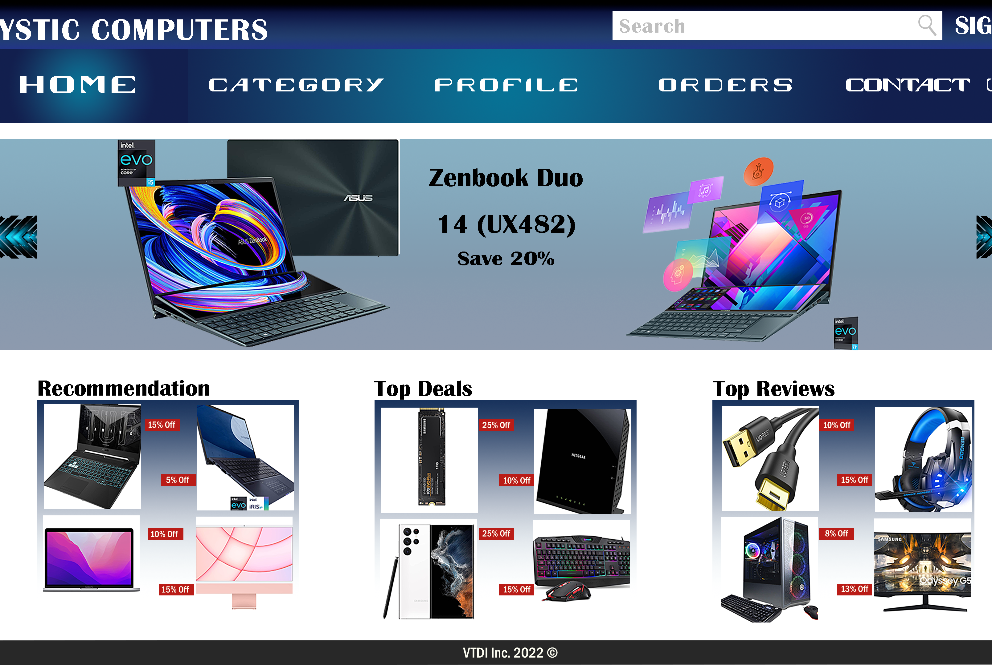
Home
The landing page is the fundamental page of our site, it shows the latest arrangements and advancements of what is avaliabe. It additionally show the surveys that we got from our clients.

Slide 7
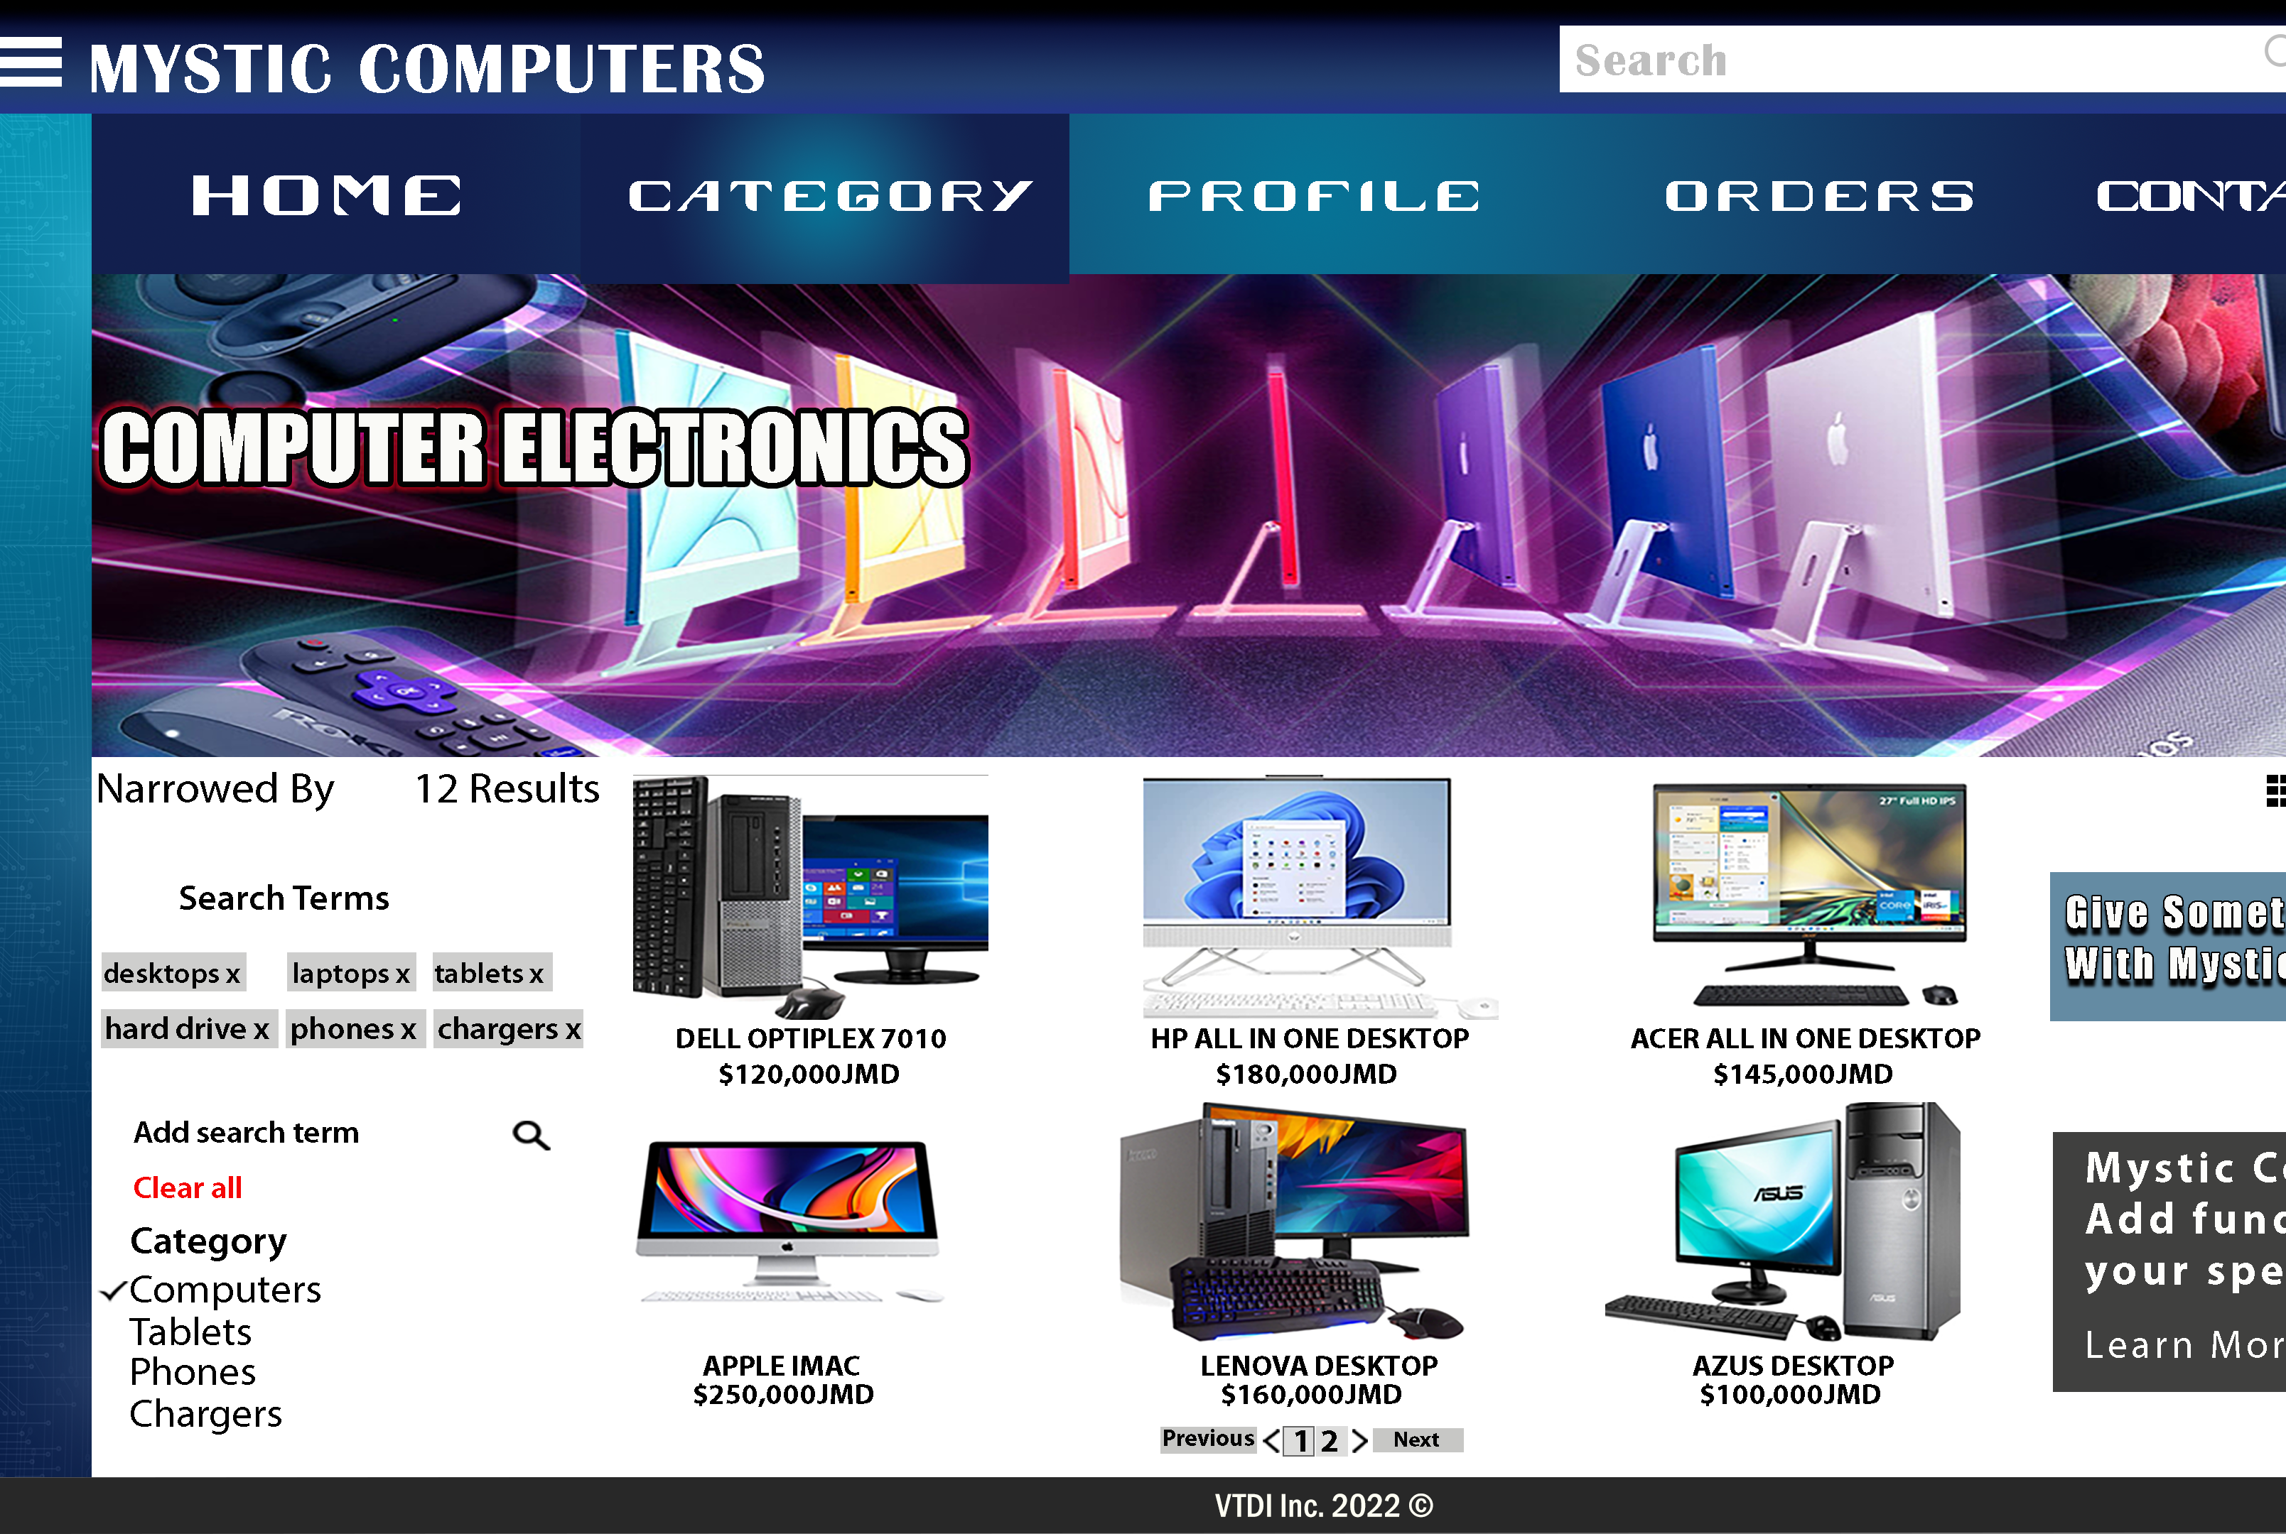
Category
The section of any website which follows the home page is called “ category”. This involves the channels, additionally, it sort choices for various items,which gives the option to quickly find any search desired.

Slide 8
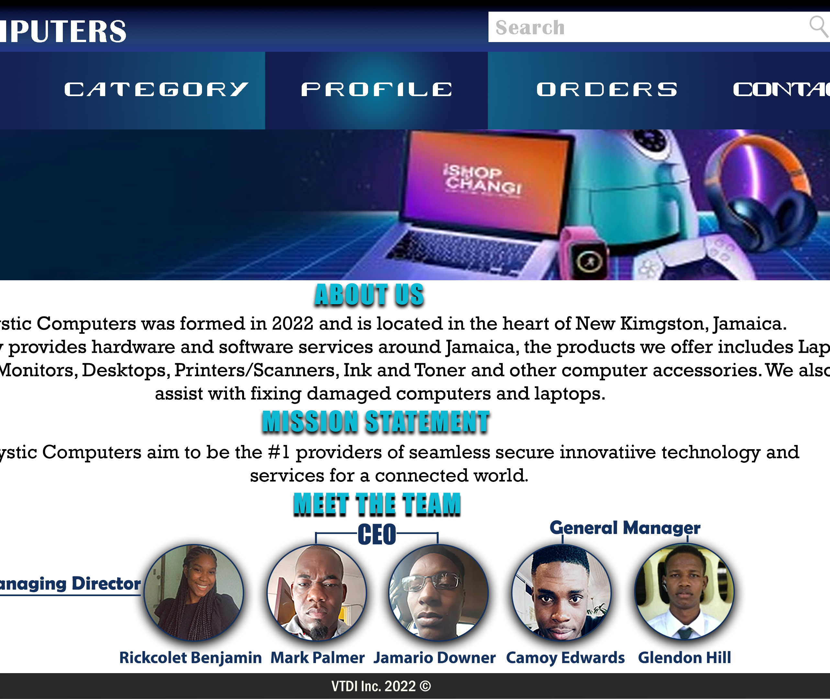
Profile
Profile maybe defined as the outline of something, on this page of any website users may find a description, mission statement and the dedicated developers of this website

Slide 9
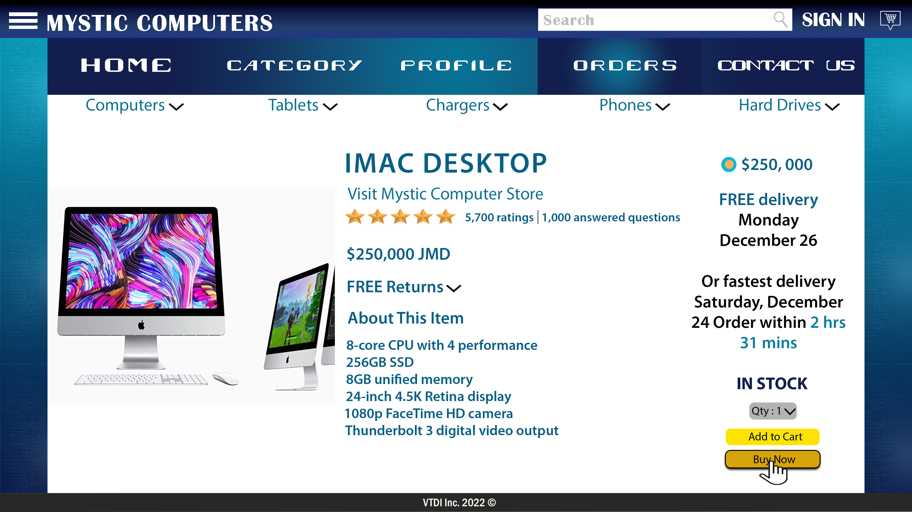
Order
This page gives additional details of an item once its selected. Details such as cost, description, and a mean to purchase the item.

Slide 10
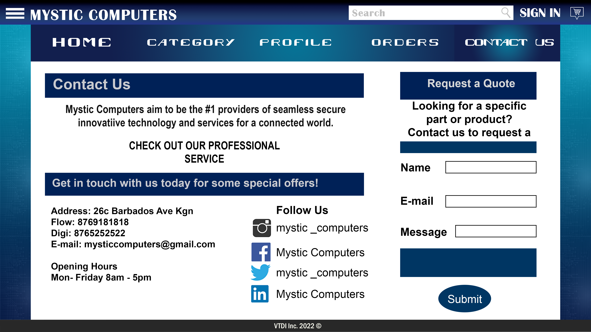
Contact Us
In finding any website having contacting information is vital. Including all social media links which gives a query page for inputting name, email and message.

Slide 11
Challenges
Challenges are difficulties encountered when completing any task. There were many challenges faced when completing these designs. Some of which includes:
Ensuring that the colors, layout and position match in order to make the design coherent with other pages.
Ensuring that similar names doesn’t override the portion of the image for each page when sliding the pages
Re-editing sections using HTML format when conducting coding

Slide 12

Lets review the website
The following link would lead you to our website;
Link : Mystic Computers

Slide 13

End of our Presentation

